Slide 1
Our course is
Primary areas of Theoretical Linguistics

Slide 2
Lecture 4
Structural linguistics
(the beginning of the 20th century–today)

Slide 3
The three main periods of linguistics are:
1) comparative linguistics (historical linguistics),
2) structural linguistics (structuralism),
3) anthropocentric linguistics (modern linguistics).

Slide 4
Revision
(Historical linguistics)

Slide 5
1. An area of linguistics that studies genetically related languages.
А) general linguistics;
B) historical linguistics;
C) anthropocentric linguistics;
D) neolinguistics

Slide 6
2. The founders of historical linguistics were:
1) Franz Bopp, Rasmus Rask, Jacob Grimm
2) A. Schleicher, Moritz Rapp, Max Muller
3) A. Leskin, B. Delbrueck, G. Paul, G. Osthof, K. Brugman

Slide 7
3. Historical linguistics is also known as:
structural linguistics
comparative linguistics
functional linguistics

Slide 8
4. Comparative linguistics was born in:
1) the 18th century
2) the 19th century
3) the 20th century

Slide 9
5. Jacob Grimm studied:
1) Slavic languages
2) Sino-Tibetan languages
3) Germanic languages

Slide 10
6. The Chinese language belongs to:
а) the Indo-European language family,
b) the Afro-Asiatic language family,
c) the Sino-Tibetan language family.

Slide 11
7. The Russian language belongs to:
а) the Indo-European language family,
b) the Afro-Asiatic language family,
c) the Sino-Tibetan language family.

Slide 12
8. The English language belongs to:
а) the Indo-European language family,
b) the Afro-Asiatic language family,
c) the Sino-Tibetan language family.

Slide 13
9. The term “language family” is about:
а) genealogical classification of languages,
b) geographical classification of languages,
c) typological classification of languages.

Slide 14
10. The impetus for developing historical linguistics was the discovery of:
а) Sanskrit,
b) Latin,
c) Greek.

Slide 15
11. Which languages are already dead?
а) Latin, Greek, Sanskrit
b) Dutch, Danish, Afrikaans,
c) Hindi, Urdu, Bengali.

Slide 16
12. Representatives of the Biological branch of historical linguistics believed that:
А) linguistics is a natural science;
B) linguistics is a social science;
C) linguistics is a psychological science.

Slide 17
13. Representatives of the psychological branch of historical linguistics believed that:
А) linguistics is a natural science;
B) linguistics is a social science;
C) linguistics is a medical science.

Slide 18
14. Historical linguistics is:
А) synchronic linguistics;
B) Diachronic linguistics;

Slide 19
15. Neo-grammarians are:
а) A. Schleicher, Moritz Rapp, Max Muller;
b) Heyman Steinthal, Moritz Latsarus, Wilhelm Wundt;
c) A. Leskin, B. Delbrueck, G. Paul, G. Osthof, K. Brugman.

Slide 20
16. Neo-grammarians believed that:
А) linguistics is a natural science;
B) linguistics is a social science;
C) linguistics is a psychological science.

Slide 21
Lecture 4
Structural linguistics
(the beginning of the 20th century–today)

Slide 22
Questions to discuss
1. What is structural linguistics?
2. Branches of structural linguistics.

Slide 23
Question 1
What is structural linguistics?

Slide 24
Structural linguistics (structuralism) is an area of linguistics that studies:
- a language as a system of structural elements (sounds, syllables, words, word-groups, sentences, etc.),
- a language as a system of symbols/signs (the basic symbol is a word).

Slide 25
Thanks to structuralists, now we know that for example:
- the Chinese language consists of 400 main syllables, 21 initials (consonants) and 36 finals (vowels), about 500,000 words, etc.;
- the Russian language consists of 35 consonants and 6 vowels, 57 word structures, 31 structures of the sentence, etc.

Slide 26
“Computer” =

Slide 27
‘Pizza’ =

Slide 28
The term "structuralism" was first used in 1939 in an article by the Dutch linguist H. Poss.

Slide 29
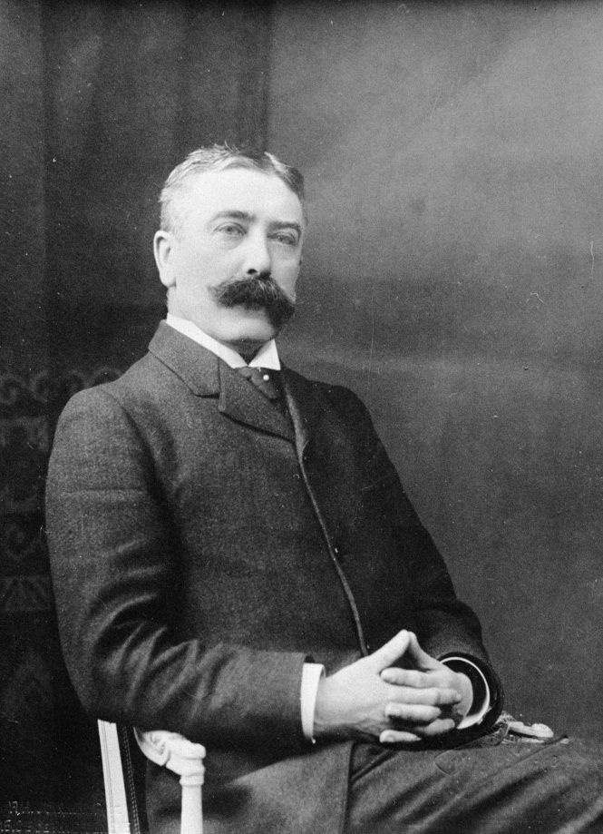
But the founder of structural linguistics was the Swiss linguist Ferdinand de Saussure (1857–1913).

Slide 30
F. de Saussure interpreted a language in the following way:
1) a language is a social phenomenon

Slide 31
2) A speech vs. a language

Slide 32
3) a language = a code
speech = a message in this code

Slide 33
4) language is an abstract phenomenon, while speech is material

Slide 34
5) a language is a national phenomenon while
speech is an individual phenomenon

Slide 35
6) a language has a form (expression, signifier) and meaning (content, signified)
Cat

Slide 36
Expression (form) meaning (content)
Panda =

Slide 37
Summary:
F. de Saussure believed:
1) a language is a social phenomenon,
2) a language is a code that is used for communication, while speech is communication,
3) a language is an abstract phenomenon, while speech is material,
4) a language is a national phenomenon while speech is an individual phenomenon.

Slide 38
Dichotomies [daɪ'kɔtəmɪz] proposed by F.Saussure:
1) speech vs. language;
2) diachrony (history) vs. synchrony (static);
3) paradigmatic relations (relations of opposition) vs. syntagmatic relations (relations of combinality).
Cat = c + a + t
Black cat = black + cat
Right vs. wrong
Student vs. students

Slide 39
QUESTION 2.
Branches (schools) of Structural Linguistics

Slide 40
Branches of structural linguistics are as follows:
1. The Prague school (1926–1952).
2. The Copenhagen School (The Danish School).
3. Descriptive linguistics (American structuralism).

Slide 41
1. The Prague school

Slide 42
1. The Prague school
Vilém Mathesius
Bohuslav Havránek
Vladimír Skalička
Bohumil Trnka
Roman Jakobson
Sergej Karcevskij

Slide 43
It is speech that should be a true object of linguistics.

Slide 44
So, they concentrated not only on the structure of the language, but also on its functions.

Slide 45
The motto of the Prague school:
structure + function

Slide 46
This is why the school is often known as
the School of functional linguistics.

Slide 47
2. The Copenhagen School (The Danish School)

Slide 48
Glossematics

Slide 49
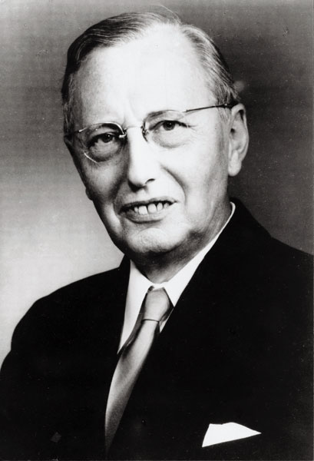
The school was founded by Louis Hjelmslev (1899–1965).

Slide 50
Louis Hjelmslev developed the theory of language known as glossematics.

Slide 51
The word “glossematics” derives from the Greek word glossa (meaning "language") and the seme (meaning “sign”).

Slide 52
So, they studied a language as a sign system.

Slide 53
The ideas that they shared with the other structural schools:
- a language is a sign system,
- a language is an abstract phenomenon,
a language consists of content (meaning) and
expression (form).

Slide 54
Specific ideas of the Danish school:
units of the language (words, syllables, sentences, etc.) are interconnected by different relations (interdependencies);
linguistics should focus not on the language units but on these interdependencies (combinability models) between language units.

Slide 55
Algebra of the language

Slide 56
The main weak points of this school:
- they showed an extremely formal approach to a language (the role of extra-linguistic factors was underestimated);
- they didn’t take into account the features of particular languages.

Slide 57
3. Descriptive linguistics (American structuralism)

Slide 58
It was founded by Franz Boas (1858-1942), Edward Sapir (1884-1939) and Leonard Bloomfield (1887-1949).

Slide 59
While European structuralism analyzed European languages, American structuralism analyzed American Indian languages.

Slide 60
The school didn’t explain why a language is arranged and used the way it is but rather focused on registering and describing language elements (that is why it is called descriptive linguistics).

Slide 61
Bloomfield's approach to linguistics was based on:
- behaviorism (a psychological theory that states that behavior is simply a response to environmental stimuli).

Slide 62
So, for Bloomfield, a language as a special form of human behavior. Language processes are like biological processes, communication is a chain of stimulie and reactions to them.

Slide 63
Conclusion.
Although the three schools of structuralism (the Prague School, the Copenhagen School and Descriptive Linguistics) share a common idea that language is a system of signs and structural formation, nevertheless, each school interprets a language in its own way.

Slide 64
Tomorrow (linguistics of discourse):
5.25 p.m. – a self-study lecture
7.20 p.m. – online lecture (zoom-conference)

Slide 65
Revision
(Structural Linguistics)

Slide 66
What do we call linguistics that studies language as a system of structural elements (sounds, syllables, words, sentences, etc.)?
а) structural linguistics,
b) historical linguistics,
c) anthropocentric linguistics

Slide 67
2. Who was the first linguist to use the term «structuralism»?
а) Z. Harris (in 1952),
b) H. Poss (1939),
c) F. de Saussure (1899)

Slide 68
3. What linguist is traditionally believed to be the founder of structuralism?
а) E. Sapir,
b) L. Bloomfield,
c) F. de Saussure

Slide 69
4. What is «dichotomy»?
а) an opposition,
b) an introduction,
c) a sign system

Slide 70
5. F. de Saussure interpreted a language as:
а) an individual phenomenon,
b) a social phenomenon,
c) a biological phenomenon

Slide 71
6. Which of these dichotomies doesn’t belong to F. de Saussure?
а) phonetics vs. phonology,
b) Language vs. speech,
c) synchronic vs. diachronic
d) paradigmatic and syntagmatic relations

Slide 72
7. What does diachronic linguistics study?
а) a language as a living organism;
b) a language at some moment of its development,
c) changes that take place in a language in time.

Slide 73
8. What is one of the main objectives of structuralism?
а) to study the history of a language,
b) to establish a degree of genealogic relations between languages,
c) To systematize all the language units and relations between them.

Slide 74
9. What relations are established between language units?
а) synchronic and diachronic,
b) internal and external,
c) syntagmatic and paradigmatic.

Slide 75
10. Who wasn’t a representative of the Prague linguistic school?
а) Bogumil Trnka,
b) Boguslav Gavranek,
c) Edward Sapir

Slide 76
11. Structuralism interpreted a language as:
а) an individual phenomenon,
b) a system of symbols,
c) a natural phenomenon

Slide 77
12. The motto of the Prague school of linguistics was:
а) structure,
b) function,
c) structure + function

Slide 78
13. What is another name for Danish structuralism?
а) grammatical linguistics,
b) glossematics,
c) physical linguistics

Slide 79
14. Who was the founder of Danish structuralism?
а) Louis Hjelmslev ,
b) L. Bloomfield,
c) V. Skalichka

Slide 80
15. What is a function (in terms of Danish structuralism)?
а) a communicative force of the sentence,
b) relations between the structural elements of the language,
c) syntactical role of words in a sentence

Slide 81
16. Who was one of the founders of American structuralism?
а) Louis Hjelmslev ,
b) L. Bloomfield,
c) V. Skalichka

Slide 82
17. Where was Descriptive linguistics born?
а) in Denmark,
b) in the Czech Republic ,
c) in the USA

Slide 83
18. What psychological theory was American structuralism based on?
Freudism,
Behaviorism,
Positivism

Slide 84
19. Which structural school does E. Sapir belong to?
а) the Prague school,
b) Glossematics,
c) Descriptive structuralism

Slide 85
20. Why is American Structuralism known as Descriptive Linguistics?

